Slide 1
ECE 471/571 – Lecture 9
Performance Evaluation
09/24/14

Slide 2
Different Approaches - More Detail
Pattern Classification
Statistical Approach
Syntactic Approach
Supervised
Unsupervised
Basic concepts:
Baysian decision rule
(MPP, LR, Discri.)
Basic concepts:
Distance
Agglomerative method
Parametric learning (ML, BL)
k-means
Non-Parametric learning (kNN)
Winner-take-all
NN (Perceptron, BP)
Kohonen maps
Dimensionality Reduction
Fisher’s linear discriminant
K-L transform (PCA)
Performance Evaluation
ROC curve
TP, TN, FN, FP
Stochastic Methods
local optimization (GD)
global optimization (SA, GA)
ECE471/571, Hairong Qi

Slide 3
Some Terminology
Often used in automatic target recognition and medical diagnosis
True positive
  The object is there and our classifier says it is there
True negative
  The object is not there and our classifier says it is not there
False negative (false misses)
  The object is there and our classifier says it is not there
False positive (false hits)
  The object is not there and our classifier says it is there

Slide 4
Some Terminology (cont’)
Sensitivity
  Probability of a true-positive = TP/(TP+FN)
Specificity
  Probability of a true-negative = TN/(TN+FP)
The probability of a correct decision = (TP+TN)/N, where N is the total number of samples

Slide 5
Some Terminology (cont’)
Precision = TP/(TP+FP)
Recall = TP/(TP+FN)
Accuracy = (TP+TN)/(TP+TN+FP+FN)
Notes:
TP+FP: Total number of elements classified positives
TP+FN: Total number of elements that actually belong to positives

Slide 6
Parameters vs. Performance
Once we have designed our classifier, we invariably have some parameters we’d like to adjust. E.g.
  Prior probability
The optimal classifier is one with sensitivity as close to 100% as possible, and at the same time with specificity as close to 100% as possible

Slide 7
ROC – Receiver Operating Characteristic
Each curve represents the performance of a particular classifier as some parameter is varied over its range
Of the three curves, the one with the sharpest bend, which passes closest to the upper left corner, is the best
Calculate the area above the curve, the one with the smallest area is the best
TPR: TP out of the total actual positives (Sensitivity or Recall)
FPR: FP out of the total actual negatives (1-Specificity)
TNR
1
0.5
0
TPR
0.5
0.5
FNR
0
0.5
1
FPR

Slide 8
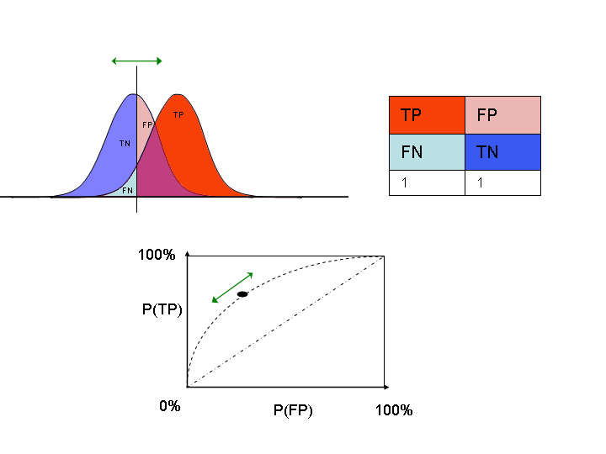
ROC (cont’d)
http://en.wikipedia.org/wiki/Receiver_operating_characteristic

Slide 9
Determine ROC from Test Data
Apparent error rate vs. true error rate
  Apparent error rate: counting the number of elements in the training set that are misclassified. However, this error rate leads to an optimistic result since the classifier has been designed to minimize the number of misclassifications of the training set
Solutions???

Slide 10
Solution 1 – Separating the training set and the test set
Divide the training set into two parts (randomly) and build the classifier using half of the data, then test the classifier on the other half. This other half is called the validation set.

Slide 11
Solution 2 – The Leave-One-Out Approach
Assume there are n points in the training set.
Remove point 1 from the set and design the classifier (determine the pdf) using the other n-1 points. Then test the classifier on point 1.
Repeat for all points.
The resulting error rate can be shown to be an almost unbiased estimate of the expected true error rate
This requires we design n classifiers. However, we only need to do it once.

Slide 12
m-Fold Cross Validation
A generalization to both solution 1 and 2.
The training set is randomly divided into m disjoint sets of equal size. The classifier is trained m times, each time with a different set held out as a validation set
For example, when m = 3,
  m1+m2 as training, test on m3
  m1+m3 as training, test on m2
  m2+m3 as training, test on m1
When m=2, it is solution 1
When m=n, it is solution 2 (n is the number of samples in the original training set)

